Slide 1
DIGITAL PORTFOLIO
Name: Somnath das.p
Register No:222407663
Department:Bsc Computer science
College : Vel Tech Ranga Sanku Art College/ University of Madras

Slide 2
DIGITAL PORTFOLIO
Digital Portfolio
Name: Somnath das .p
BSc Computer Science, 2nd Year
Key Skills: Web Development, Creative Design
Projects: chess game, website, portfolio
Contact: [Email] | [GitHub]

Slide 3
AGENDA
Problem Statement
Project Overview
End Users
Tools and Technologies
Portfolio design and Layout
Feature and functionalities
Results and Screenshot
Conclusion
GitHub Link

Slide 4
PROBLEM STATEMENT
➢ In today’s digital era, traditional resumes are not enough to
effectively showcase skills and projects.
➢ Many students and professionals lack a structured online
presence to highlight their work and achievements.
➢ A digital portfolio offers an interactive and accessible
solution to present skills, experiences, and accomplishments
in a modern, engaging way

Slide 5
PROJECT OVERVIEW
➢ Brief summary: This project is a digital portfolio to professionally
present my background, skills, and creative work.
➢ Contains key sections: About Me, Projects, Skills, and Contact for easy
navigation.
➢ Main idea: Showcase personal achievements, highlight technical
expertise, and display completed projects in an organized manner.

Slide 6
WHO ARE THE END USERS?
Students: Showcase academic projects, assignments, and build resumes
for further studies.
Job Seekers: Share skills, experience, and portfolio with recruiters and
employers.
Freelancers: Present work samples and completed projects to attract
potential clients.
Professionals: Highlight career achievements, expertise, and ongoing
development.

Slide 7
TOOLS AND TECHNIQUES
HTML: Builds the main structure of all portfolio pages and sections.
CSS: Styles the portfolio with colors, layouts, and makes it responsive for all device sizes.
JavaScript: Adds interactivity-navigation menu, animations, and form validation.
Code Editor: Developed using VS Code for efficient coding.
Hosting: Published online using GitHub Pages for easy sharing and access.

Slide 8
PORTFOLIO DESIGN AND LAYOUT
Organized sections:
➢ Home/About Me, Projects, Skills, Contact.
➢ Consistent color scheme and clean typography throughout the portfolio.
➢ Easy navigation bar for smooth movement between sections.
➢ Visual elements like icons and images for better engagement.
➢ Fully responsive layout optimized for both mobile and desktop devices.

Slide 9
FEATURES AND FUNCTIONALITITY
➢ Navigation bar with smooth scrolling for easy access to all
sections.
➢ Project showcase including images and detailed descriptions for
each project.
➢ Interactive elements such as hover effects and animations to
enhance user engagement.
➢ Contact form with validation to ensure correct and complete user
input.
➢ Responsive design that works seamlessly on desktop, tablet, and
mobile devices.

Slide 10
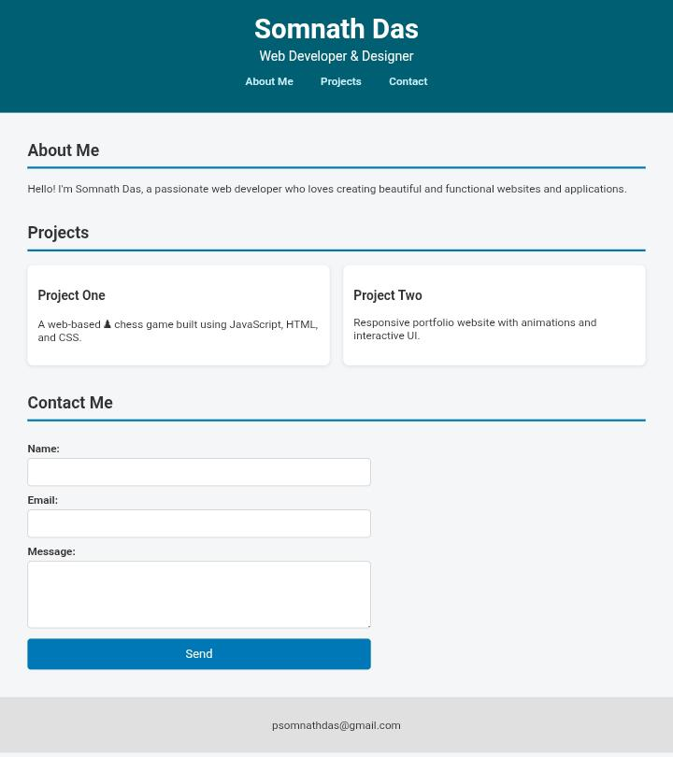
RESULTS AND SCREENSHOTS

Slide 11
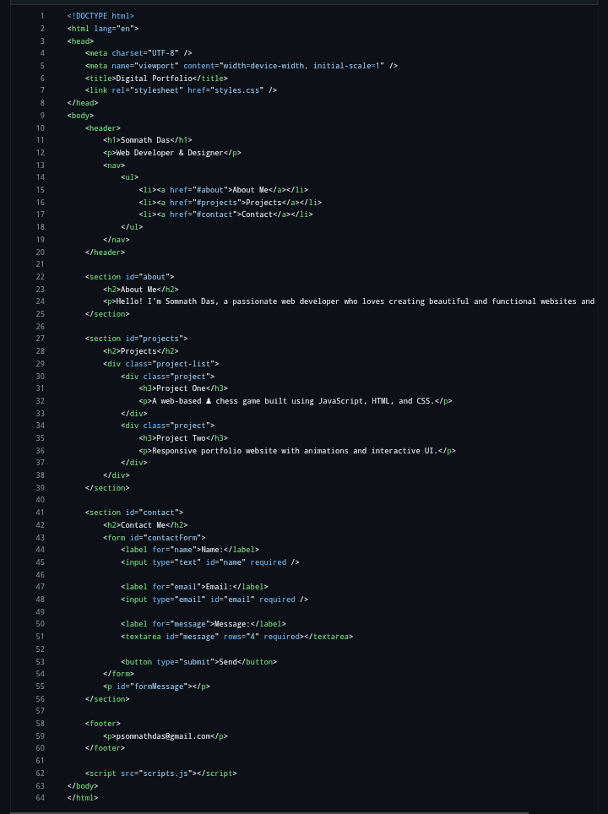
HTML

Slide 12
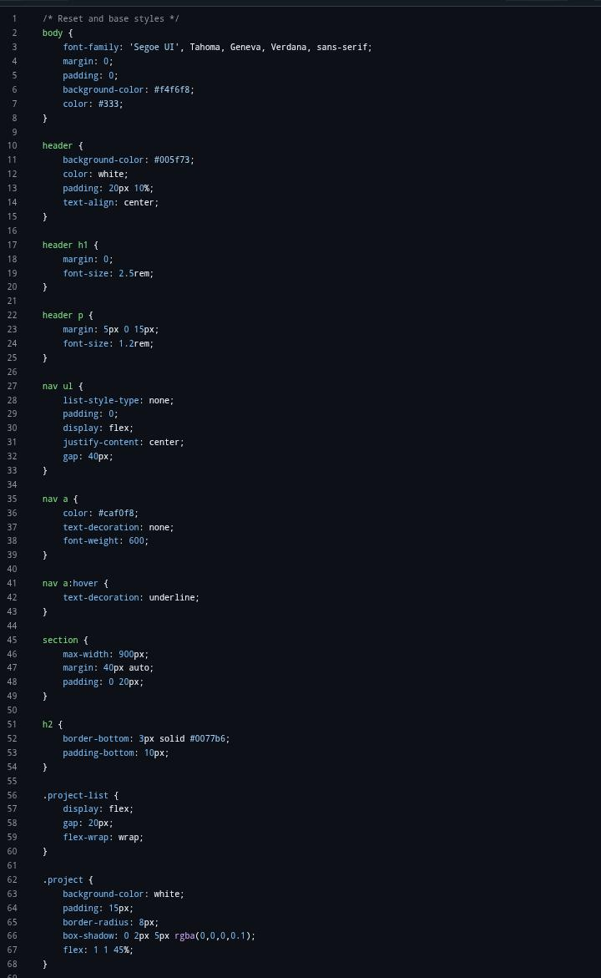
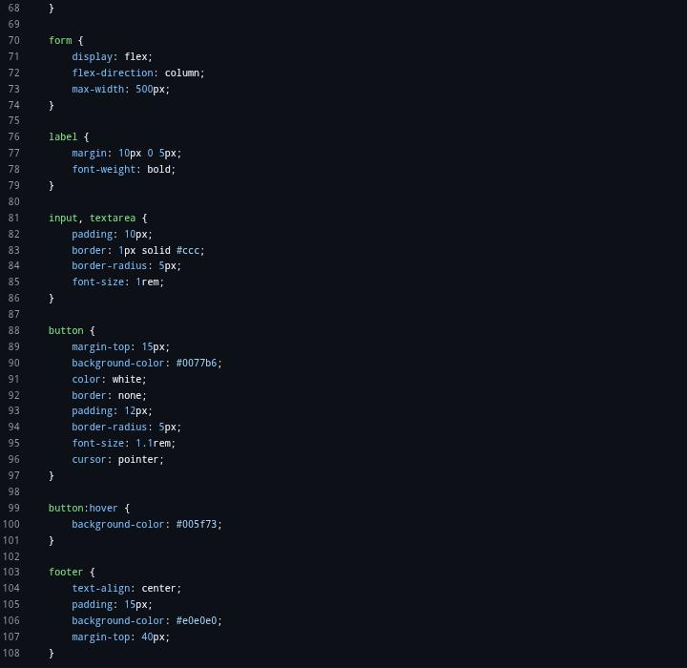
CSS

Slide 13
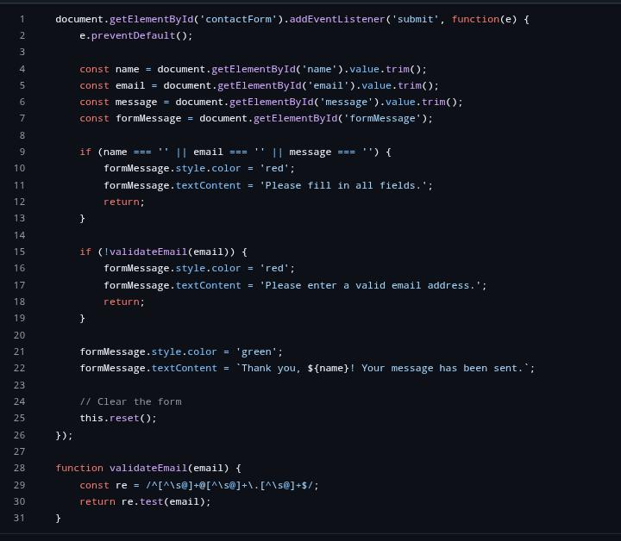
JAVASCRIPT

Slide 14
CONCLUSION
Highlights of Your Project:
➢ Integrates both technical (coding, web development) and creative (design,
wallpapers, logos) projects in a single portfolio.
➢ Features a user-friendly, visually attractive layout for easy navigation and
engagement.
➢ Provides interactive elements like clickable project links and external profiles for
deeper exploration.

Slide 15
Final Summary
➢ Demonstrates a holistic approach to personal branding and self-presentation
in the digital age.
➢ Offers a comprehensive record of skills, achievements, and creative growth
beyond traditional resumes.
➢ Acts as a dynamic platform adaptable for academic, professional, and creative
opportunities
Benefits to society
➢ Encourages students and professionals to showcase their real skills and passion authentically.
➢ Fosters inspiration and knowledge sharing among peers, educators, and professionals.
➢ Helps bridge the gap between talent and opportunity, supporting career growth and collaboration.

Slide 16


